Slide 1
Secure Remote Viewer (SRV)
TN User Guide
10.26.2023

Slide 2
Training Content
Log In
Set-up
Site Access
Infant Search

Slide 3
Set-up: Browsers
Supported Browsers
  Mozilla Firefox
  Chrome
  Edge

Slide 4


Set-up: Image Reader
To be able to view the results the computer will need to have the ability to view PDF images.
http://get.adobe.com/reader

Slide 5
Set-up: Pop-up Blocker
To ensure that authentication can occur properly as well as ensure the result pop-ups appear, the computer will need the Pop-up Blocker turned OFF for the browser.
Users can modify the browser settings to enable pop-ups for specified web sites.

Slide 6
Set-up: Enable Cookies
This site has been created based on utilizing Browser Cookies. The browser used must be set up to enable cookies.
Users can modify the browser settings to allow specified sites to set cookies on the computer.

Slide 7
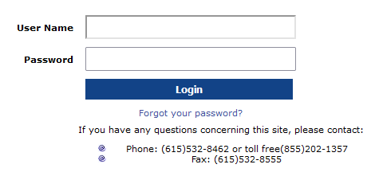
Site Access: Login Page
Site access is only granted to pre-approved users. Each user will need an account set up by the Department of Health.
Once the log in credentials have been provided, the users will enter the following web address: https://newborn.health.tn.gov/toolbar/login.aspx

Slide 8
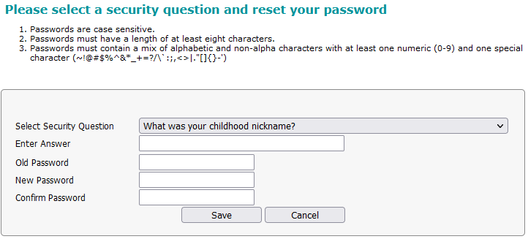
Site Access: User’s First Log In
When the log in credentials are being used for the first time, the system will prompt the user to:
Create their own password (other than the system generated password
Select a security question and input an answer
Once the Save button is selected the system will store the new password and return to the login page where the user will enter username and new password.
Note: Security question/answer allows for tighter security.

Slide 9

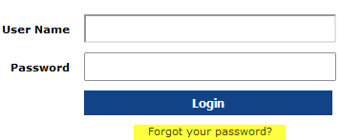

Site Access: Forgot Password
If the username or password, do not match what is stored in the system a prompt will appear and the user will be instructed to re-enter a valid username or password. After 3 unsuccessful attempts the user will be locked out and must contact the TN Newborn Screening Program for access.
If you can’t remember the password the system will allow the user to reset the password in a few simple steps.
  Select link on the log in page
  Enter the username for the account
  Enter the answer to the security question
  Click Submit and the log in page will appear
Note: When logging in with the reset password ensure the entire new password is entered. Each time a password is reset the following data will need to be re-entered 1) security question 2) the reset password and new password

Slide 10
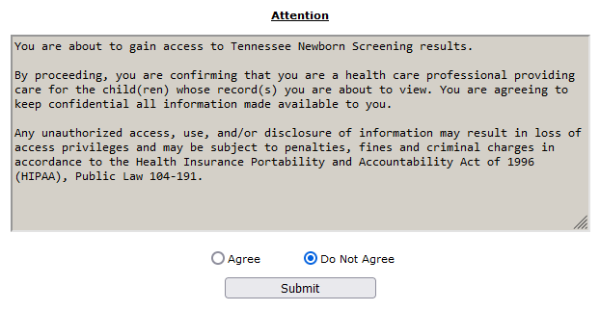
Site Access: Disclaimer Page
The user will need to agree to the disclaimer for access to the system.

Slide 11
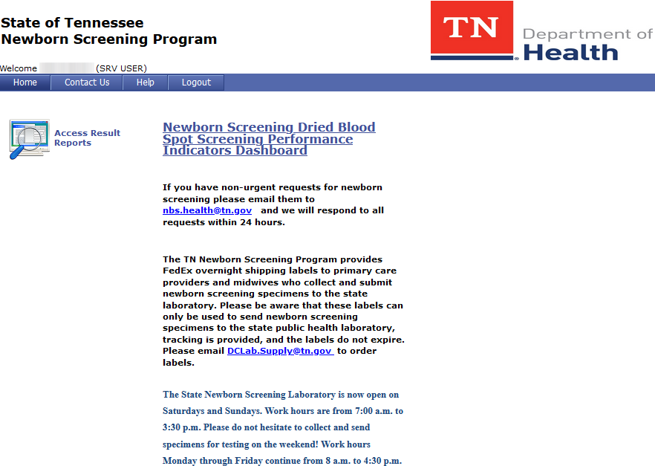
Site Access: Log In to Landing Page
When the log in credentials are entered the system will bring the user to the default home page:
  View contact information for the State
  Log out of the SRV system
  View informational messages posted by the State
  Access Result Reports

Slide 12
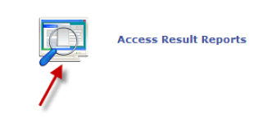
Infant Search: Getting Started
The user is now able to search for an infant by selecting the icon names Access Results Reports from the landing page.

Slide 13
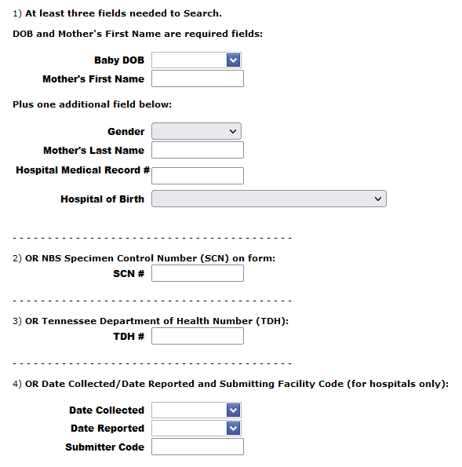
Infant Search: Search Criteria
An infant can be found one of four ways:
  Entering the infant’s DOB and Mother’s First name in addition to any one of the following fields:
      Gender
      Mother’s Last Name
      Hospital Medical Record #
      Hospital of Birth
  2. SCN # (Specimen Control Number/Form), the pre-
  printed ID number on the blood collection card.
  3. Tennessee Department of Health# (TDH#),also known
  as the Lab No
  4. Date Collected or Date Reported and Submitting
  Facility Code which would be the code for the
  Collection Hospital.

Slide 14

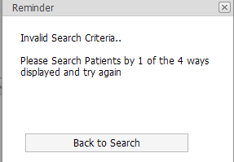
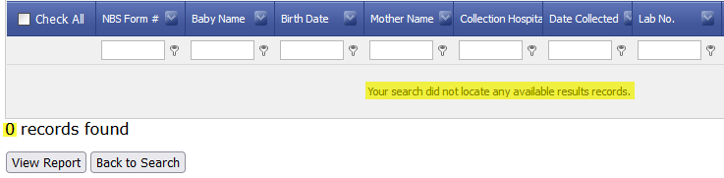

Infant Search: Search Criteria
Once the search criteria has been entered select the button at the bottom of the page.
If you want to clear or re-enter the search criteria, select the button at the bottom of the page.
If the minimum criteria hasn’t been
entered “invalid search criteria” will display
If the system is unable to find results that match the grid will display the message below:
To perform another search, the user must click the Back to Search.

Slide 15
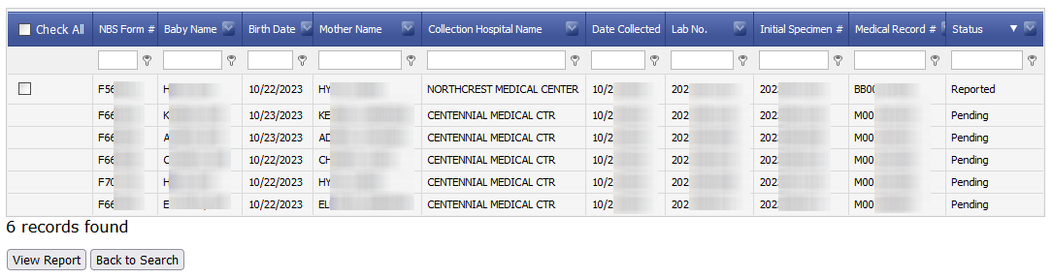
Infant Search: Search Results Grid
If the system finds results that match the search criteria the resulting grid will display with all the infants that fall within the criteria entered.
Note: Some information has been cleared from the grid to comply with HIPAA regulations

Slide 16
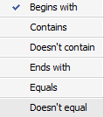
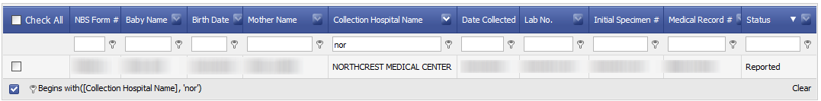
Infant Search: Search Results Grid
The results grid allows the user to perform an additional filter if more than one result displays on the grid.
In this example, “nor” has been entered in the filter field for Collection Hospital to filter down to anything beginning with ‘nor’. The filter is set to ‘Begins with’ but can be changed by the user.
To return to the original set of search the user would selecting ‘Clear’ in the lower right corner of the grid.

Slide 17
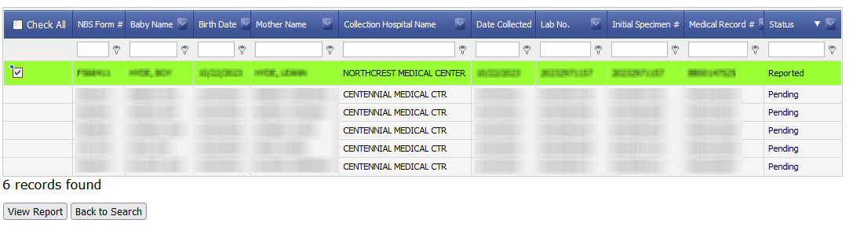
Infant Search: View Results
If the specimen is in the lab but not yet reported the Status column will display Pending and a check box to view the report is not visible.
If the Status is Reported, a check box will display. Once the infant is located the user would simply check the box next to the name (which highlights the row(s) in a green background) and the View Report button at the bottom of the page.
Note: Multiple results can be selected at one time.

Slide 18

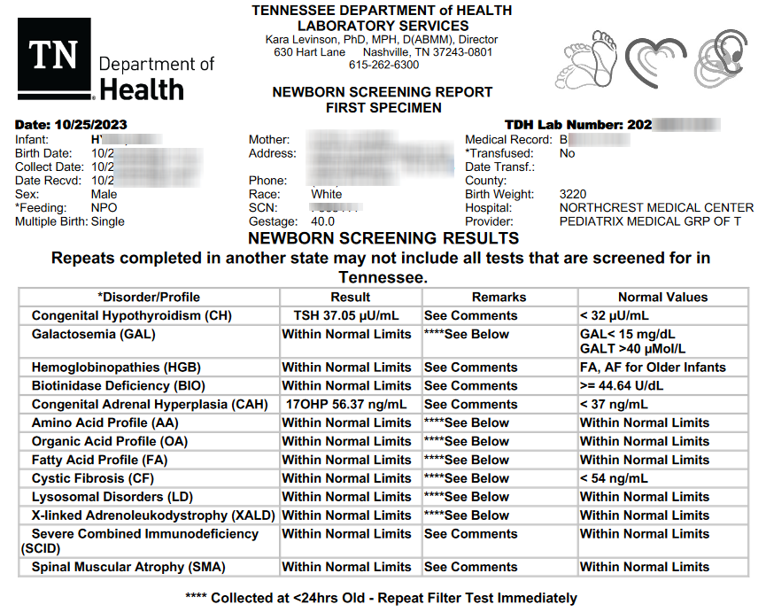
Infant Search: View Results
After view report is selected a pop-up appears prompting the user to open the file.
The results will display as a PDF file.
The user can view, print or save the results .pdf file as needed.
When finished viewing/saving the results the user can close the document window and the search results will still be available.

Slide 19
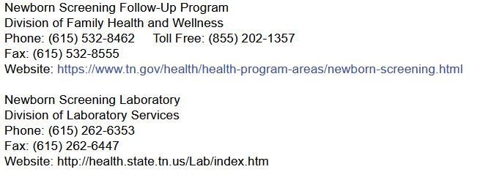
State Contacts
If you have questions or require additional assistance, please reach out to the contacts below:

